Slide 1
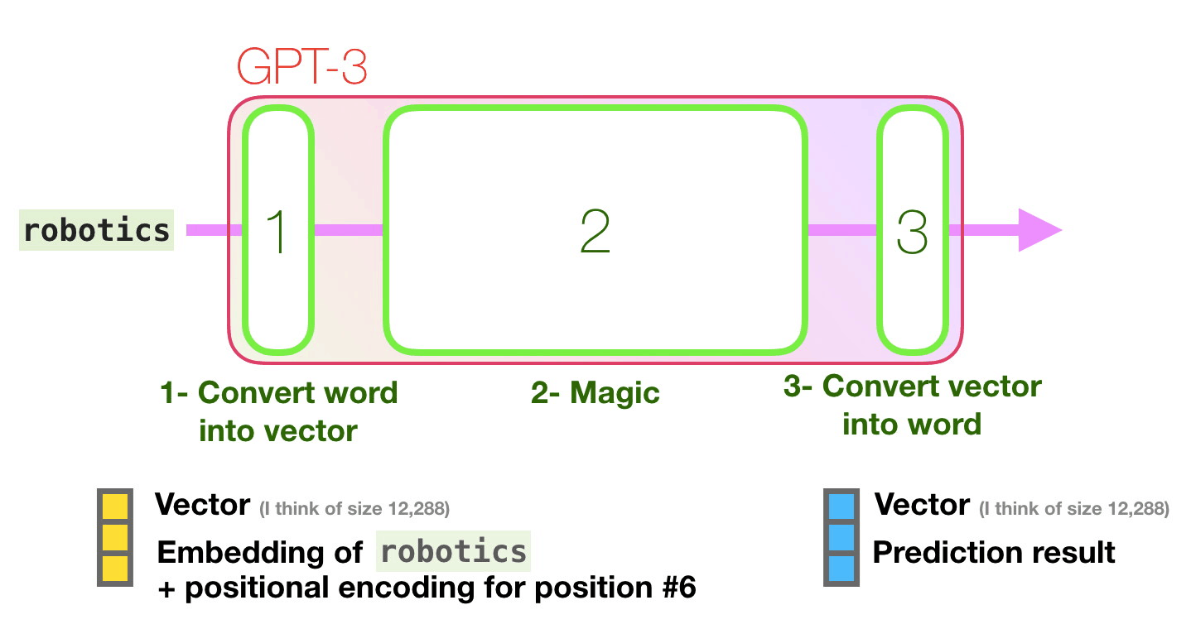
GPT 3
https://jalammar.github.io/how-gpt3-works-visualizations-animations/

Slide 2
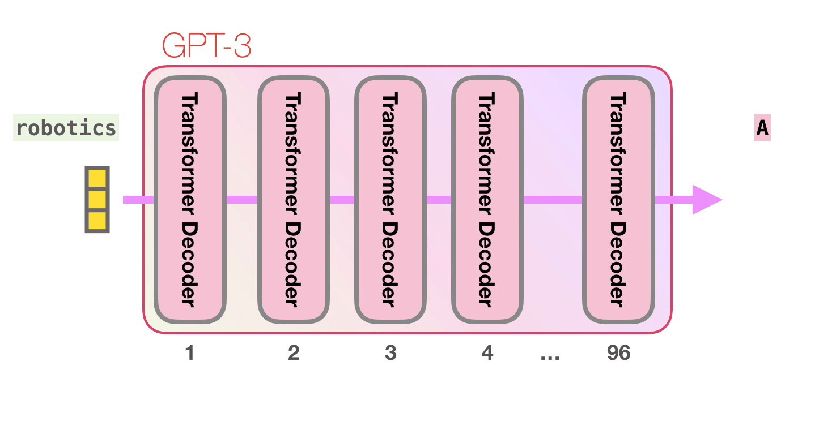
GPT 3
https://jalammar.github.io/how-gpt3-works-visualizations-animations/

Slide 3
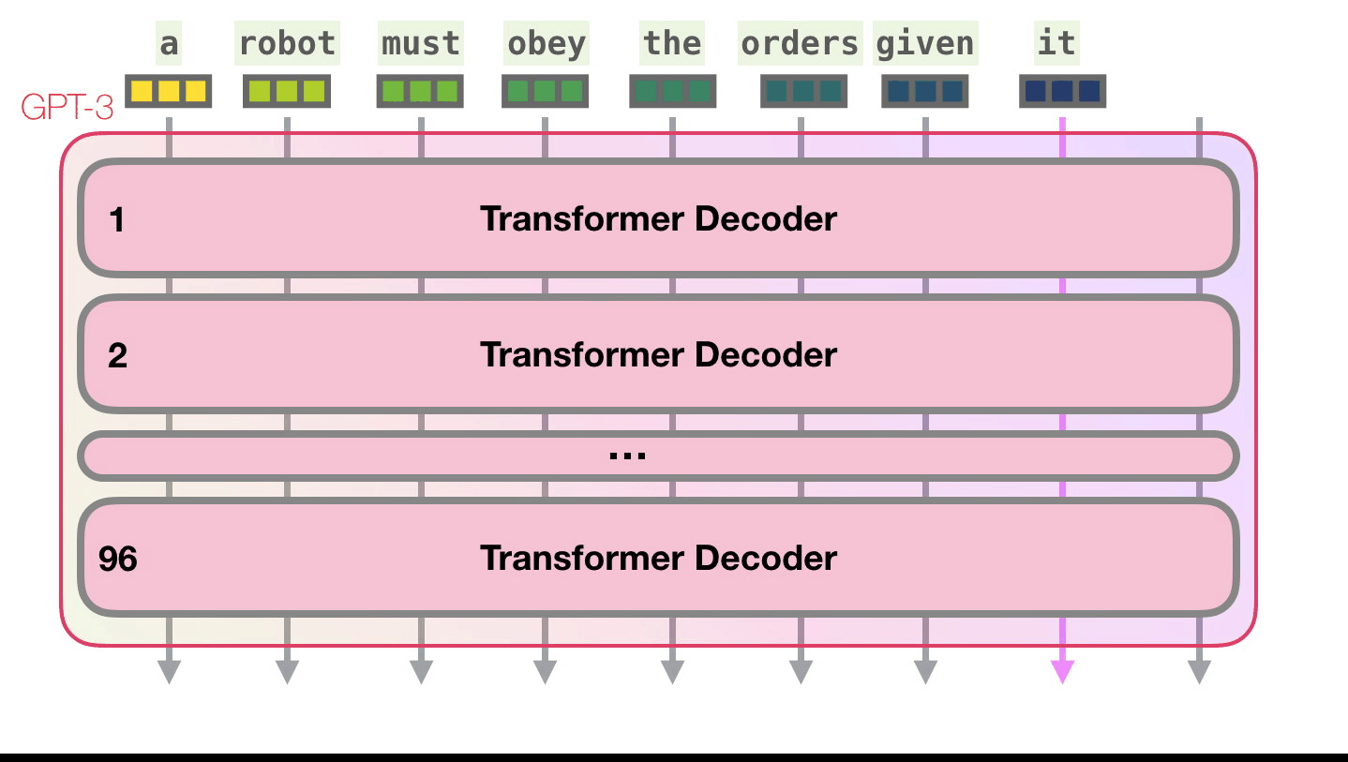
GPT 3
https://jalammar.github.io/how-gpt3-works-visualizations-animations/

Slide 4
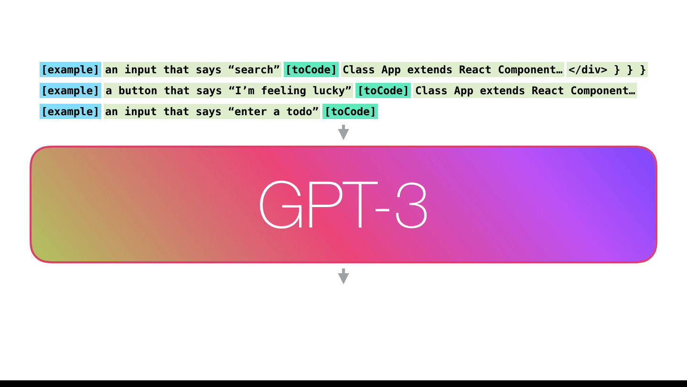
GPT 3
https://jalammar.github.io/how-gpt3-works-visualizations-animations/

Slide 5
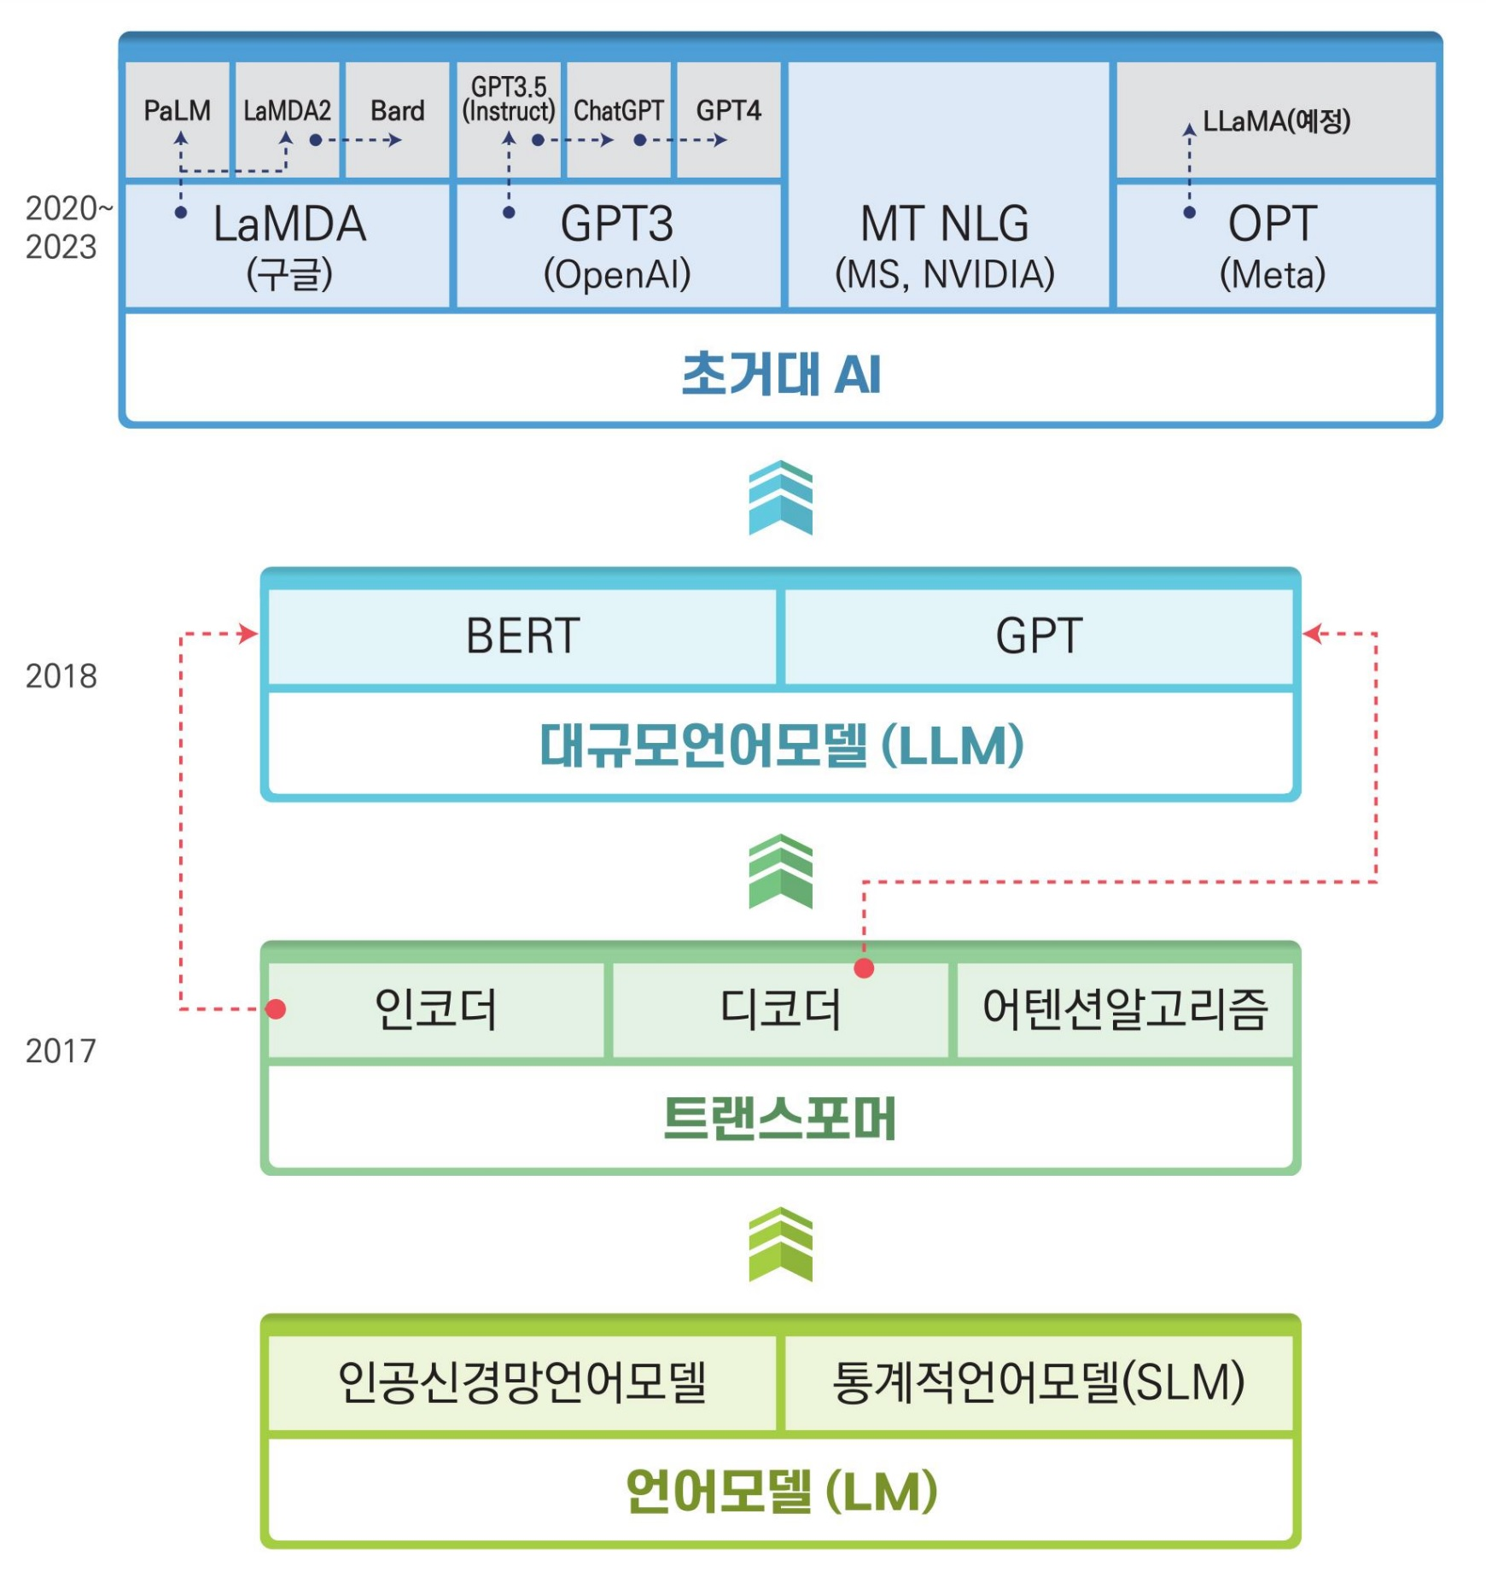
GPT 3
대규모_언어모델_기반의_공공분야_초거대_AI_도입방향

